Slide 1

AKA CAD
Nesting Innovation for Optimal Material Efficiency
July 18 2024

Slide 2




Digital Processing in CNC CAD Industries
1000x1000
1000x1000
1000x1000
Key result
1000x1000
800x600
800x600
800x1000
800x1000
800x1000
800x1000
Key result
Raw Material Sheets
CNC-Cut 2D Objects

Slide 3
Common CNC-Cut 2D Objects in Manufacturing
Key result
Key result
Key result
CNC-Cut 2D Objects

Slide 4




Transforming Real-World Designs into Digital Masterpieces for CNC
7
7
9
9
Using 2D scanning, manual design in CAD software, and CNC probing to digitally replicate physical objects
6
6
6
6
Initial CNC Designs for 2D Objects
Digitized Versions for Optimized Nesting

Slide 5
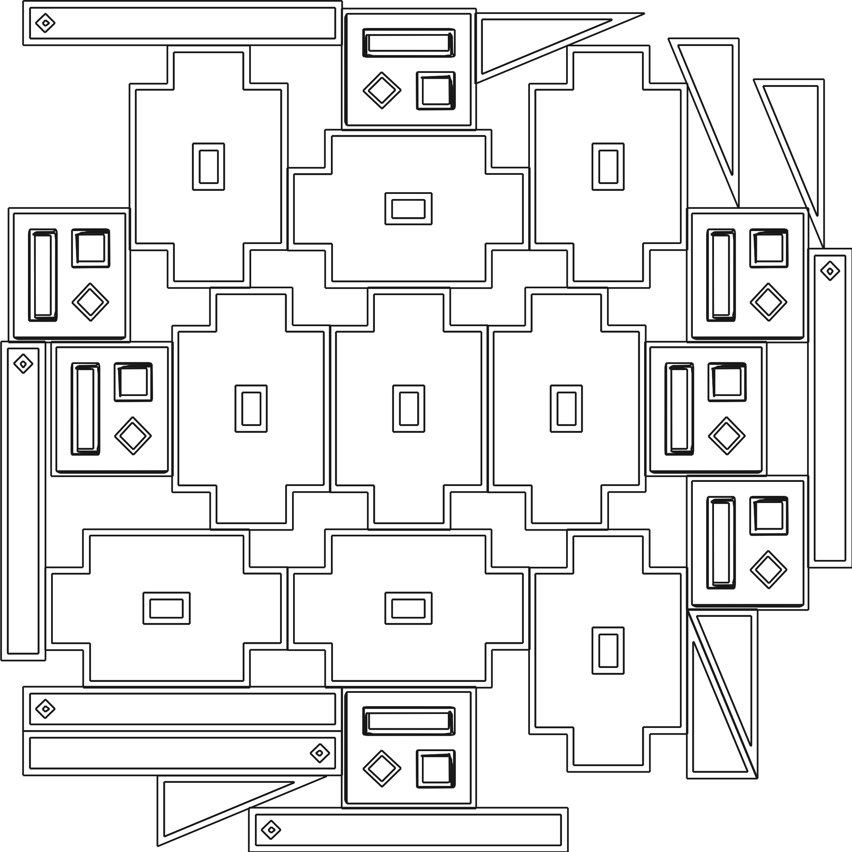


Mastering Single-Material Nesting
The process begins by placing digitally prepared objects onto a digitized material sheet. The nesting tool then creates a raw digital version that is optimized for material usage. This version is ready for CNC cutting, enabling the precise fabrication of 2D objects in reality
1000x1000
1000x1000
7
9
6
6
Digitized Versions for Optimized Nesting
Digitized Material Sheet
Ready-to-Cut Nesting Blueprint

Slide 6

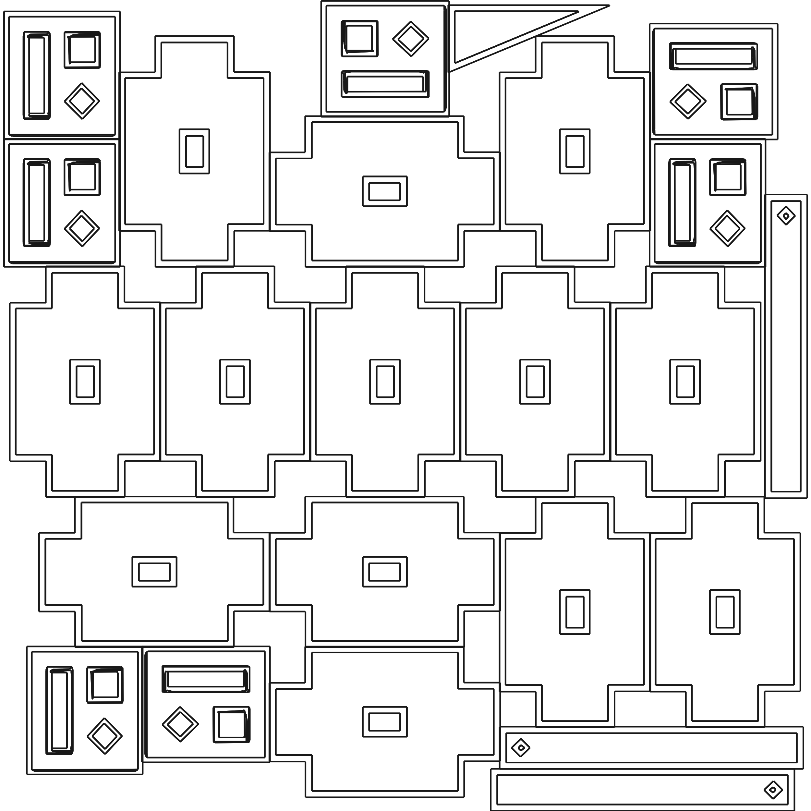
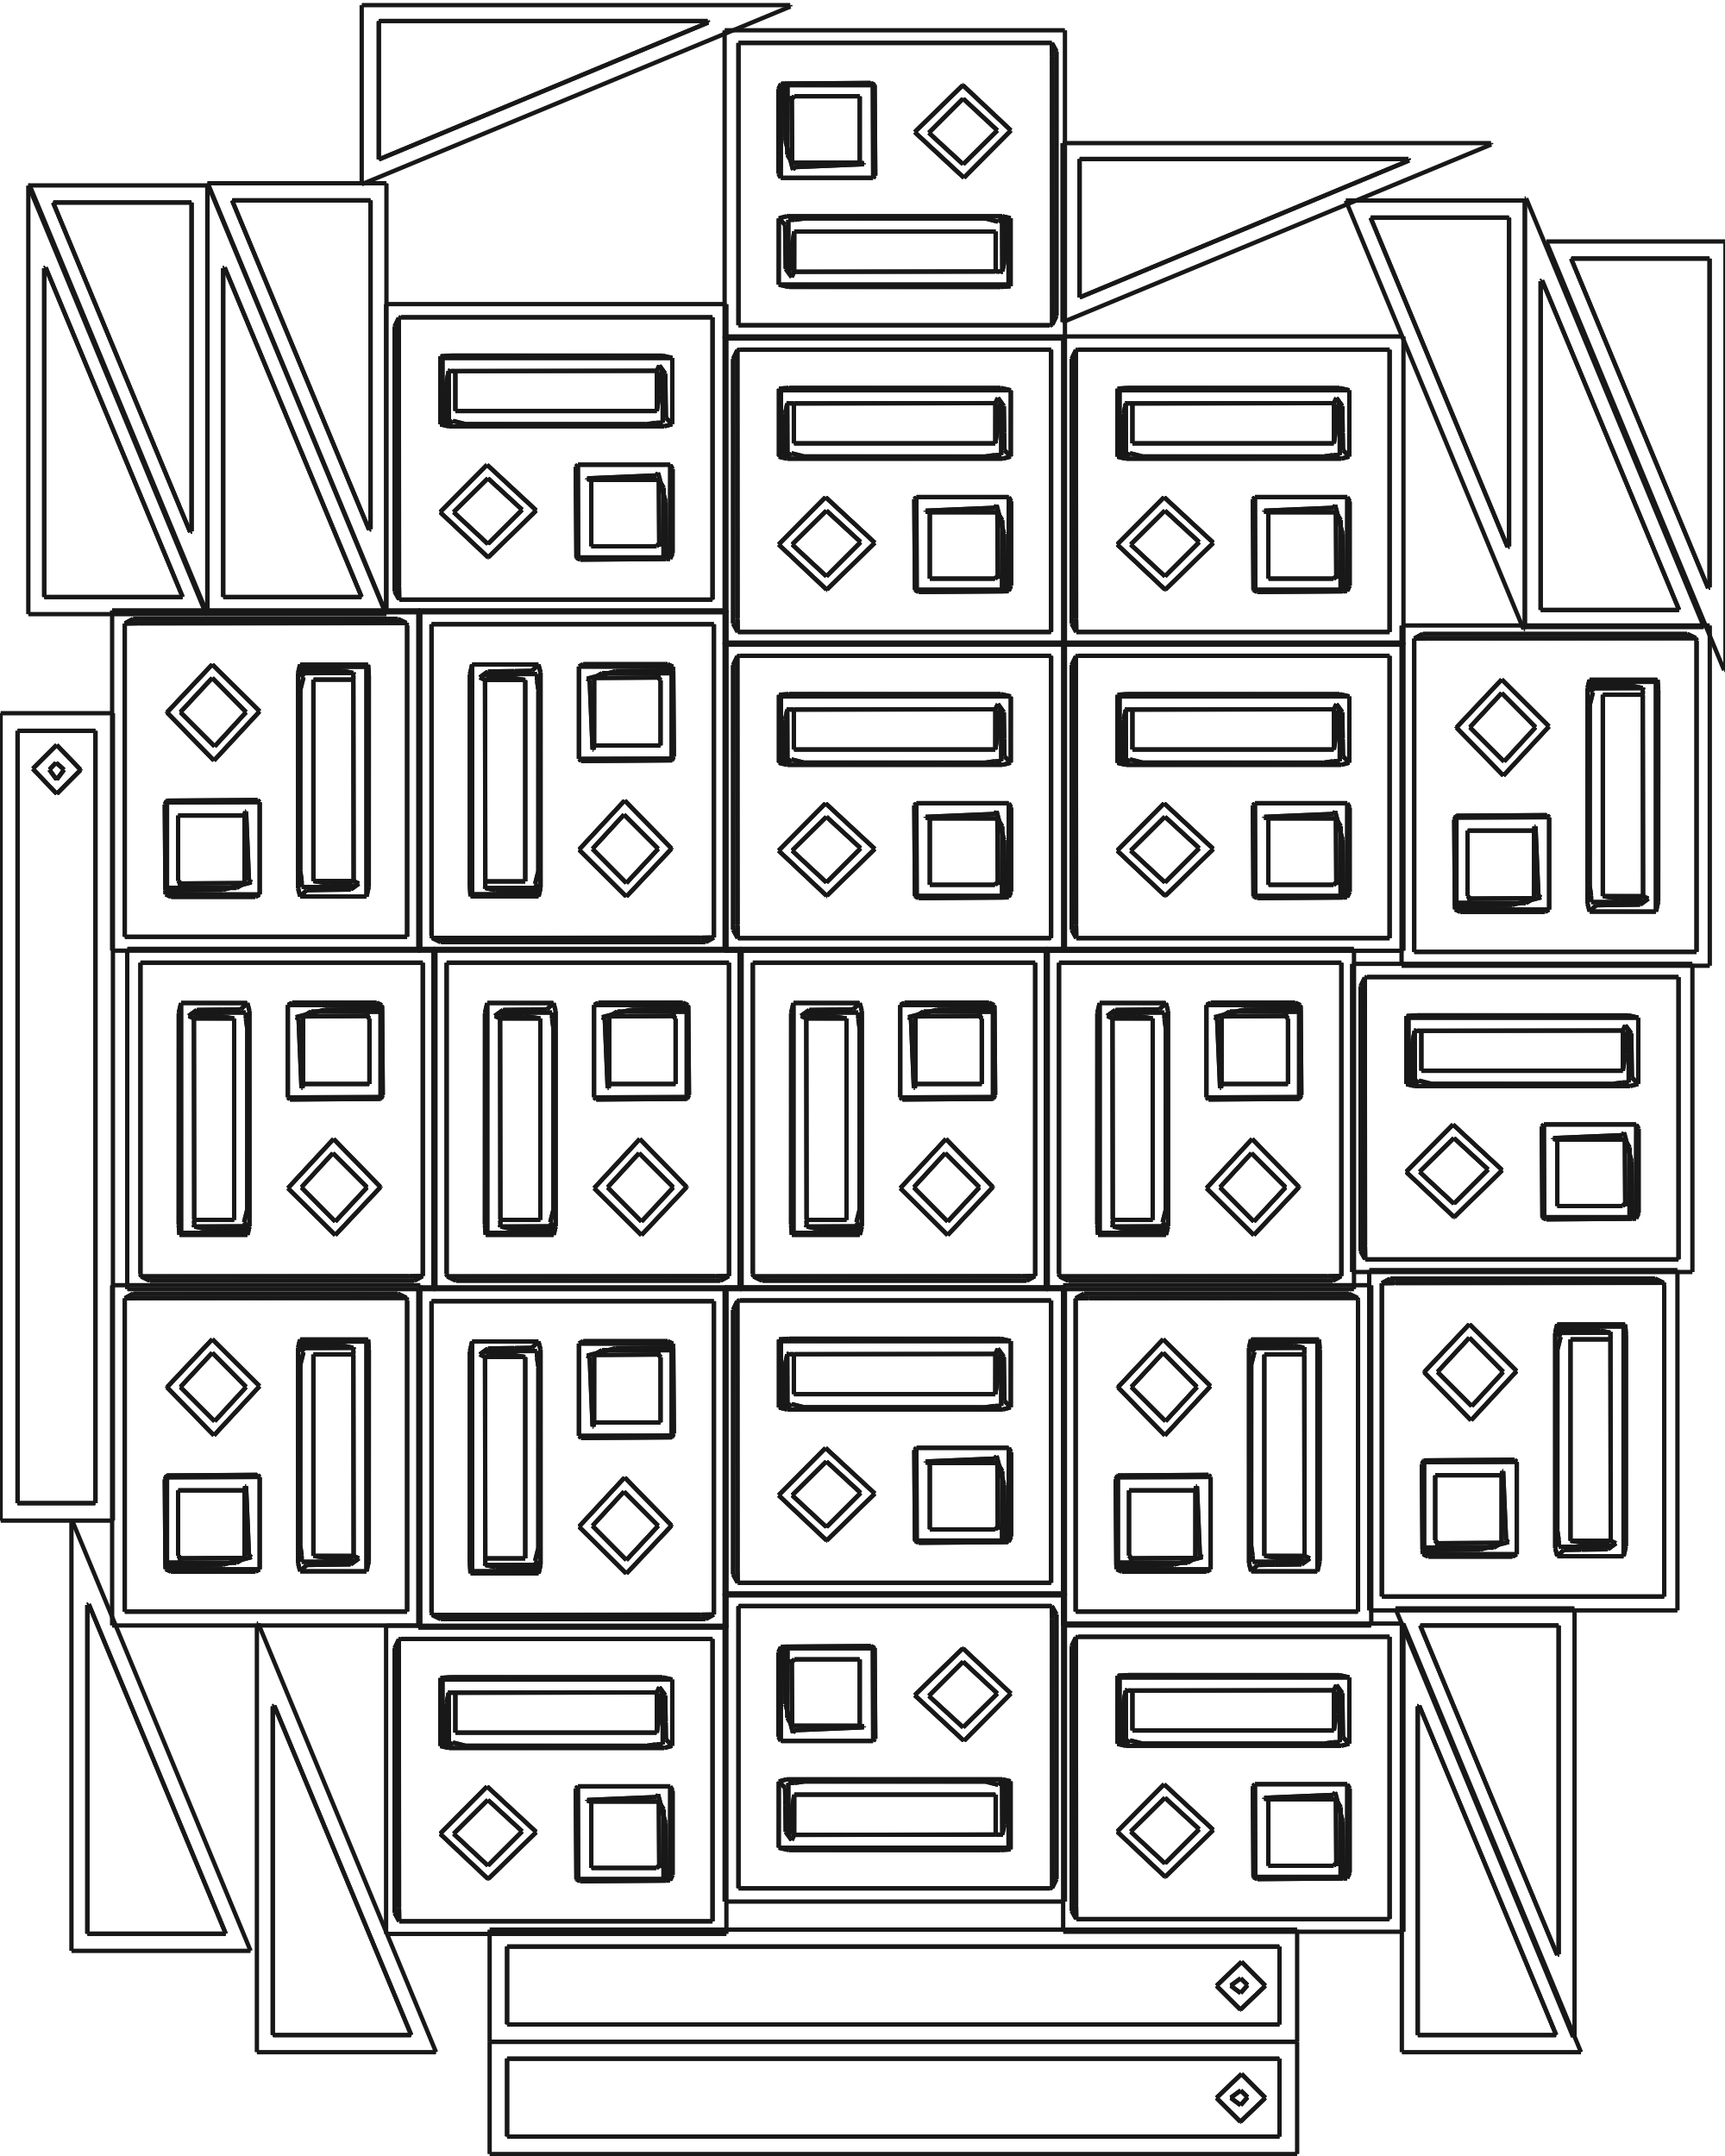
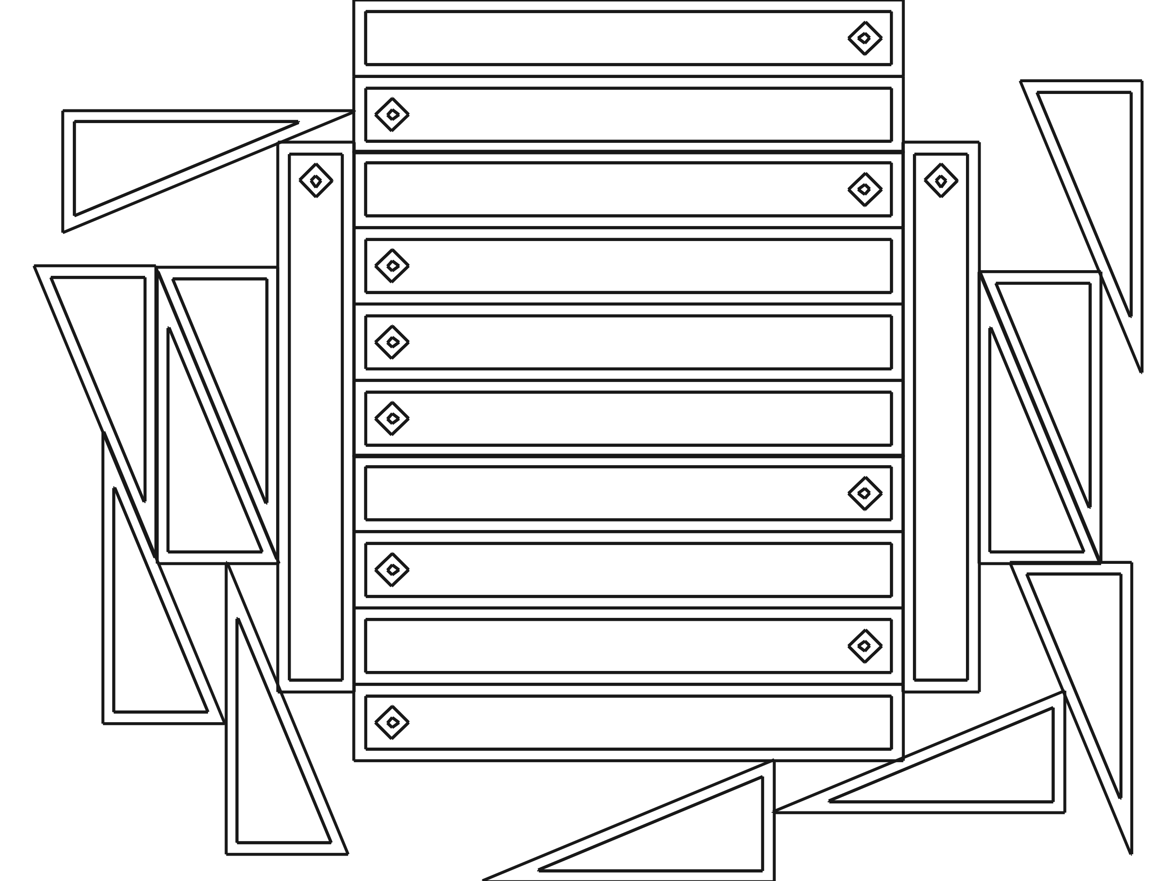
Multi-Material Nesting Capabilities
The nesting tool is capable of handling multiple objects and materials simultaneously, optimizing the use of various-sized materials to enhance material efficiency and reduce waste.
7
1000x1000
9
6
6
Digitized Versions for Optimized Nesting
Digitized Material Sheet
Ready-to-Cut Nesting Blueprint
1000x1000
800x1000
29
13
800x600
6
6

Slide 7

CONTACT US
FPT Cau Giay Building, Duy Tan Street, Dich Vong Hau Ward, Cau Giay District, Hanoi City, Vietnam Tel.: +84 (24) 3 768 9048 Fax: +84 (24) 3 768 9049
Contact Person: Mr/Ms.ABC Head of ABC
Email: abc@fpt-software.com

